Slide 1

Research Progress Update: Weeks 1 & 2
Presenter: Nanshun Wang

Slide 2
Overview
Smooth Diffusion (Guo et. al 2023)
Code: Smooth-Diffusion/train_smooth_diffusion.py at main · SHI-Labs/Smooth-Diffusion · GitHub
Paper: formulation of introduction and related works
Next steps for my current research

Slide 3
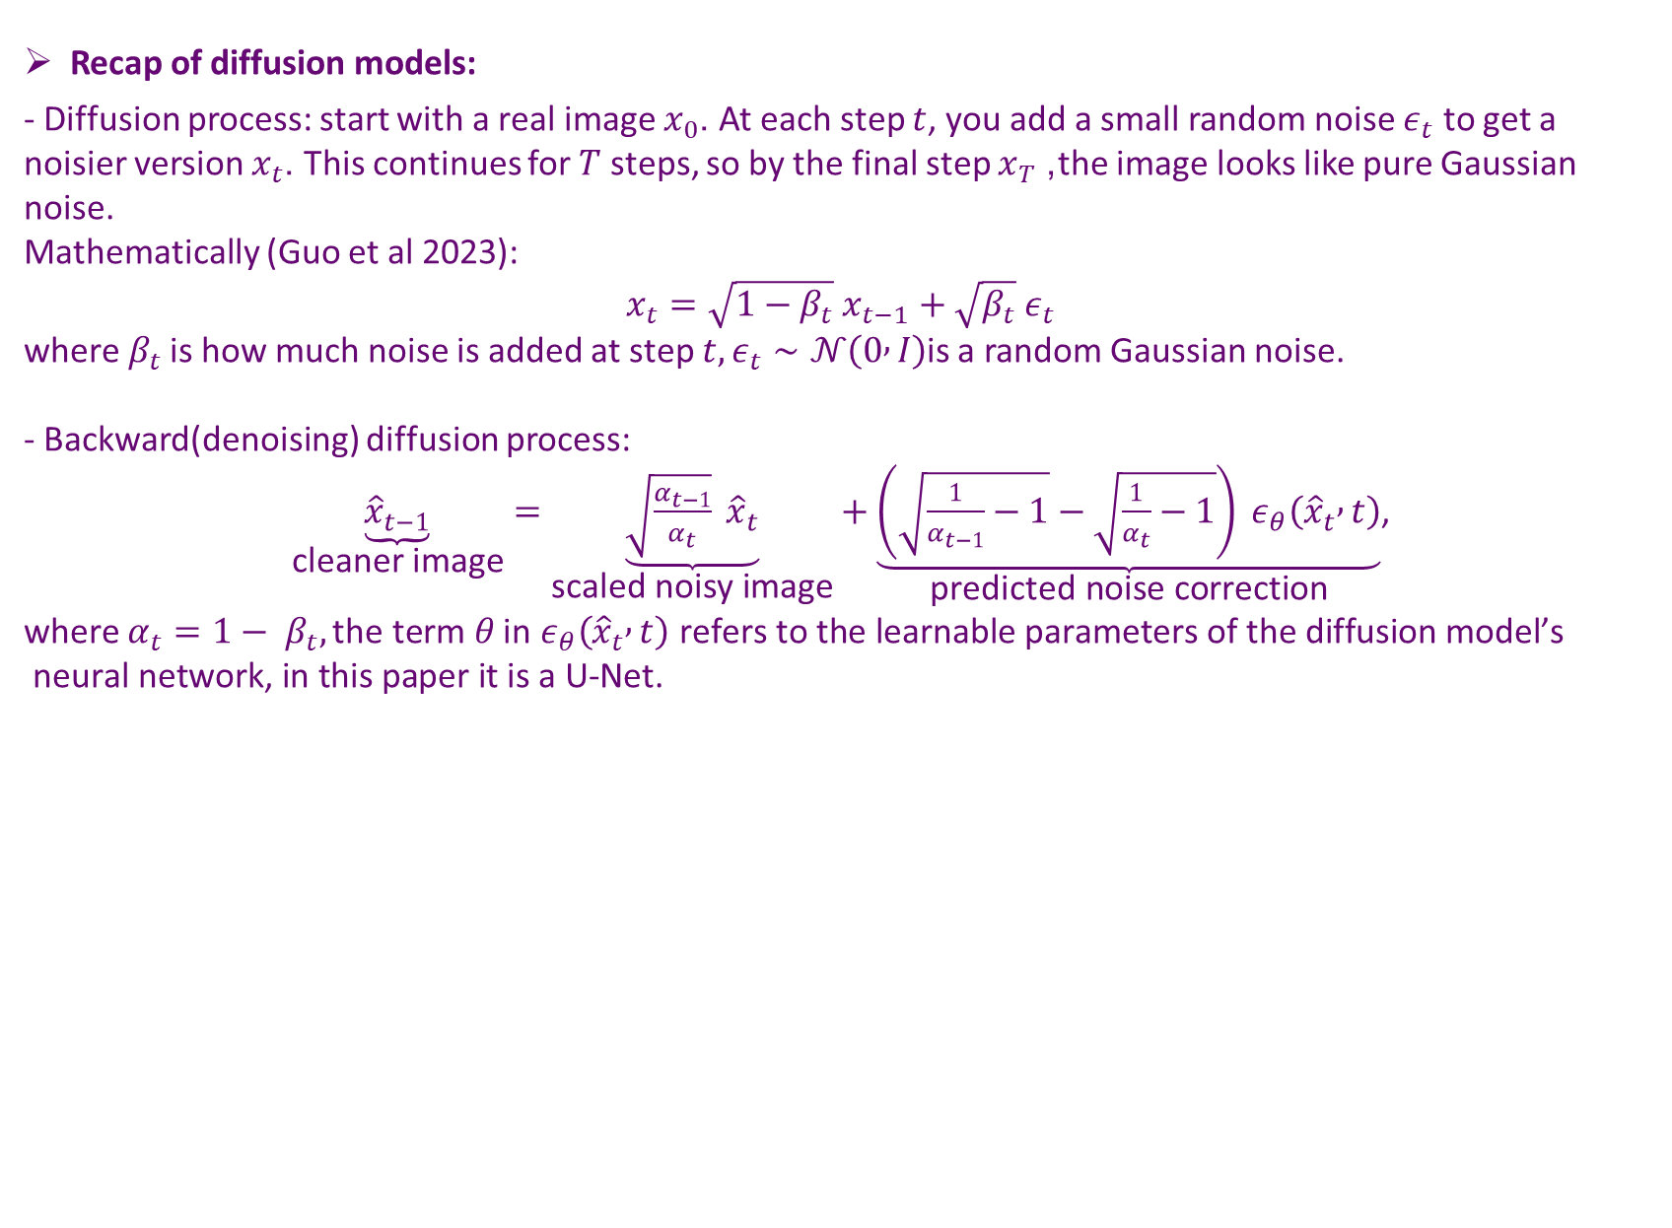
Smooth Diffusion (Guo et. al 2023)
Recap of diffusion models:
- Diffusion process: start with a real image $x_{0}$. At each step $t$, you add a small random noise $ε_{t}$ to get a noisier version $x_{t}$. This continues for $T$ steps, so by the final step $x_{T}$, the image looks like pure Gaussian noise.
Mathematically (Guo et al 2023):
$$x_{t}=\sqrt{1−β_{t}} x_{t−1}+\sqrt{β_{t}} ε_{t}$$
where$β_{t}$ is how much noise is added at step $t,ε_{t}∼𝒩\left(0 , I\right)$is a random Gaussian noise.
- Backward(denoising) diffusion process:
$\underset{\text{cleaner} \text{image}}{\underbrace{{\hat{x}}_{t−1}}}=\underset{\text{scaled} \text{noisy} \text{image}}{\underbrace{\sqrt{\frac{α_{t−1}}{α_{t}}} {\hat{x}}_{t}}}+\underset{\text{predicted} \text{noise} \text{correction}}{\underbrace{\left(\sqrt{\frac{1}{α_{t−1}}−1}−\sqrt{\frac{1}{α_{t}}−1}\right) ε_{θ}\left({\hat{x}}_{t} , t\right)}}$,
where $α_{t}={1− β}_{t},\text{the} \text{term} θ \text{in} ε_{θ}\left({\hat{x}}_{t} , t\right) \text{refers} \text{to} \text{the} \text{learnable} \text{parameters} \text{of} \text{the} \text{diffusion} \text{model}\text{’}\text{s} \text{neural} \text{network}\text{, }\text{in} \text{this} \text{paper} \text{it} \text{is} \text{a} \text{U}\text{-}\text{Net}\text{.}$

Slide 4
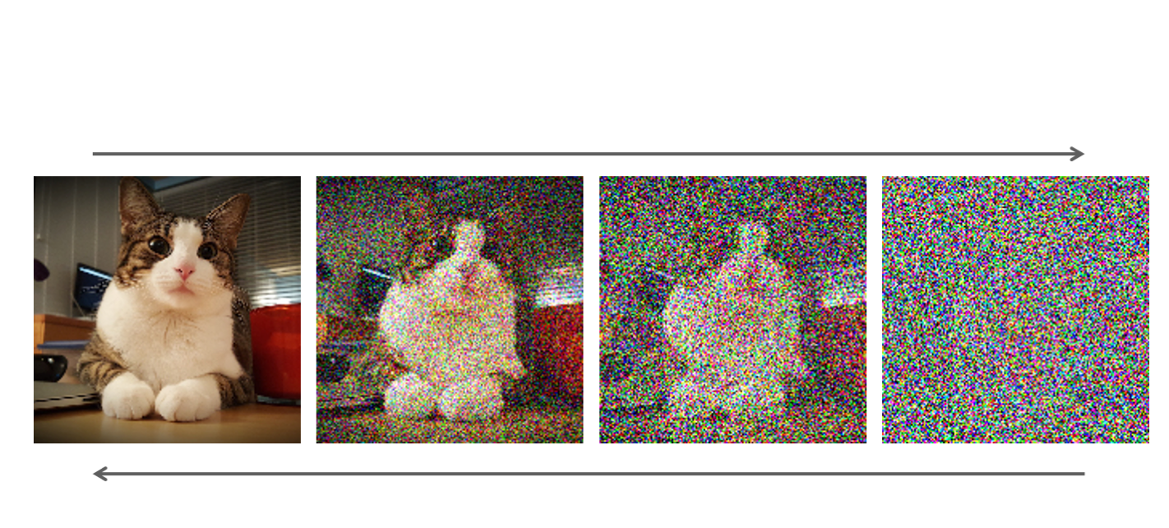

Smooth Diffusion (Guo et. al 2023)
Why smooth diffusion?
- The overall objective of smooth diffusion is that if you make a small, fixed-size change $Δε$in the input noise (the starting point), you should get a proportional, predictable change in the final generated image
In symbols:
$∥Δ{\hat{x}}_{0}∥_{2} ⇔ C∥Δx_{T}∥_{2}=C∥Δε∥_{2}, ∀ε$,
where $C$ is a constant, $Δε$ is a small fixed sized change in the input noise.
However, this is what we want after all the T steps, but to train this in one go is computationally expensive. This is solved by an approach that draws inspiration from the regularization technique adopted in GAN training (Karras et. al 2020).

Slide 5

Smooth Diffusion (Guo et. al 2023)
How? Step-wise Variation Regularization
- Solution: $∥Δ{\hat{x}}_{0}∥_{2} ⇔ C∥Δx_{T}∥_{2}=C\sqrt{1−\overline{α_{t}}}∥Δε∥_{2}, ∀ε$
If we treat the model as a function: $\hat{x_{0}}=f_{θ}\left(ε\right)$. Then, in order to know how $\hat{x_{0}}$ responds to $ε$ (we want this be a constant), we take the partial derivative of $\hat{x_{0}}$ with respect to $ε$ tells us that sensitivity.
$$J_{ε}=\frac{∂\hat{x_{0}}}{∂ε}$$
This is the Jacobian matrix, and we do not want it to be too large because a small input noise will then lead to a big change in the image. The next step is to regularize it so that it penalizes big Jacobian values.

Slide 6

Smooth Diffusion (Guo et. al 2023)
Step-wise Variation Regularization (continued)
-.In the paper(also Karras et. al 2020), this regularization term is
$L_{reg}=𝔼_{Δ\hat{x_{0}},ε}[\sqrt{1−\overline{α_{t}}} ∥J_{ε}^{T}Δ\hat{x_{0}}∥_{2}− a]^{2}$,
where $\overline{α_{t}}=\prod_{t=1}^{T}{α_{t}}, a=$ the exponential moving average of $\sqrt{1−\overline{α_{t}}} ∥J_{ε}^{T}Δ\hat{x_{0}}∥_{2}$during training on the computer, $Δ\hat{x_{0}}$is the normally sampled pixel intensities normalized to unit length.
- How do we train? By backpropagation on$\sqrt{1−\overline{α_{t}}} ∥J_{ε}^{T}Δ\hat{x_{0}}∥_{2}$. But this is also not feasible. $J_{ε}$ is an m times n matrix where ${(J}_{ε}{\left.)\right.}_{ij}=\frac{∂(x_{0}{\left.)\right.}_{i}}{∂ (ε{\left.)\right.}_{j}}$, which means calculating every partial derivative
In practice we use $∥∇_{ε}\left(\sqrt{1−\overline{α_{t}}} \hat{x_{0}}⋅Δ\hat{x_{0}}\right)∥_{2}$ because $\sqrt{1−\overline{α_{t}}} ∥J_{ε}^{T}Δ\hat{x_{0}}∥_{2}=∥∇_{ε}\left(\sqrt{1−\overline{α_{t}}} \hat{x_{0}}⋅Δ\hat{x_{0}}\right)∥_{2}$
The gradient can be then be obtained using backpropagation, because deep learning frameworks (PyTorch, TensorFlow) already compute ∇ easily.
(explanation continues on next page)

Slide 7
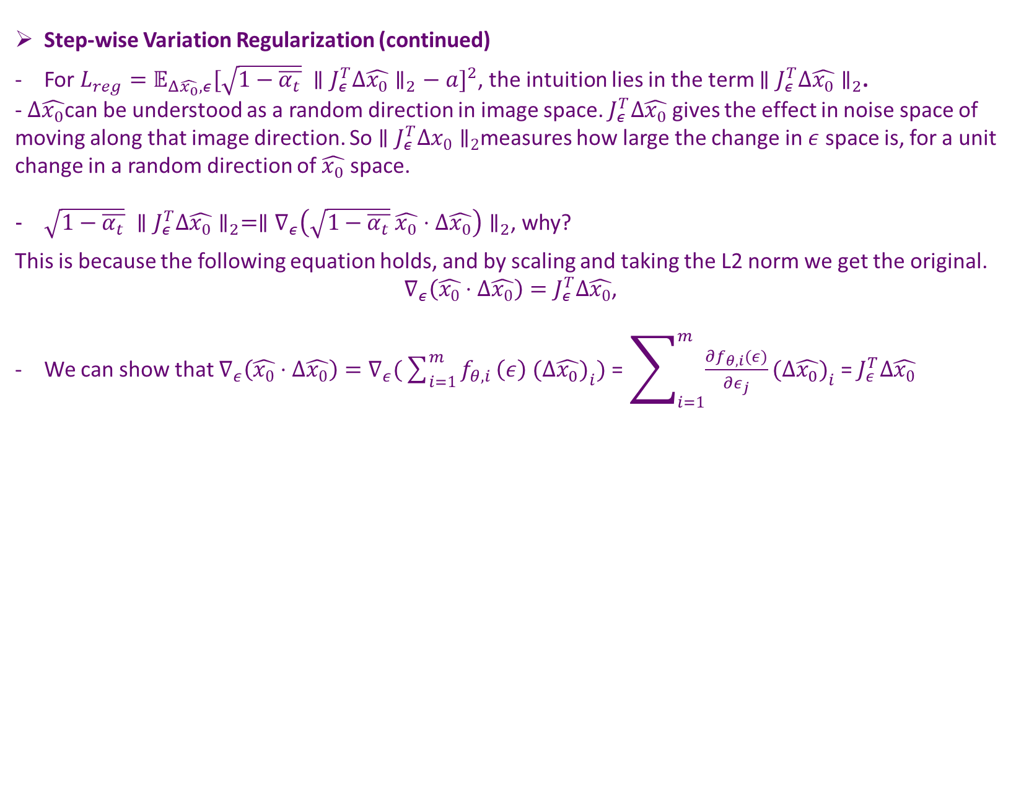
Smooth Diffusion (Guo et. al 2023)
Step-wise Variation Regularization (continued)
For $L_{reg}=𝔼_{Δ\hat{x_{0}},ε}[\sqrt{1−\overline{α_{t}}} ∥J_{ε}^{T}Δ\hat{x_{0}}∥_{2}− a]^{2}$, the intuition lies in the term $∥J_{ε}^{T}Δ\hat{x_{0}}∥_{2}$.
- $Δ\hat{x_{0}}$can be understood as a random direction in image space. $J_{ε}^{T}Δ\hat{x_{0}}$ gives the effect in noise space of moving along that image direction. So $∥J_{ε}^{T}Δx_{0}∥_{2}$measures how large the change in $ε$ space is, for a unit change in a random direction of $\hat{x_{0}}$ space.
$\sqrt{1−\overline{α_{t}}} ∥J_{ε}^{T}Δ\hat{x_{0}}∥_{2}=∥∇_{ε}\left(\sqrt{1−\overline{α_{t}}} \hat{x_{0}}⋅Δ\hat{x_{0}}\right)∥_{2}$, why?
This is because the following equation holds, and by scaling and taking the L2 norm we get the original.
$∇_{ε}\left(\hat{x_{0}}⋅Δ\hat{x_{0}}\right)=J_{ε}^{T}Δ\hat{x_{0}}$,
We can show that $∇_{ε}\left(\hat{x_{0}}⋅Δ\hat{x_{0}}\right)=∇_{ε}(\sum_{i=1}^{m}{f_{θ,i}}\left(ε\right) (Δ\hat{x_{0}}{\left.)\right.}_{i})$ = $\sum_{i=1}^{m}{\frac{∂f_{θ,i}(ε)}{∂ε_{j}}(Δ\hat{x_{0}}{\left.)\right.}_{i}}$ = $J_{ε}^{T}Δ\hat{x_{0}}$
This holds only if $Δx_{0}$ is independent of $ε.$
$$(since Δx_{0}∈ℝ^{m})$$

Slide 8

Smooth Diffusion (Guo et. al 2023)
Step-wise Variation Regularization (continued)
- Using the preliminary that ${{(J}_{ϵ}^{}⋅J}_{ϵ}^{T}=𝒦⋅I)$minimizes $L_{reg}=𝔼_{Δ\hat{x_{0}},ε}[\sqrt{1−\overline{α_{t}}} ∥J_{ε}^{T}Δ\hat{x_{0}}∥_{2}− a]^{2} ,$
We have $J_{ϵ}^{T}$= $𝒦J_{ϵ}^{−1}$, thus $J_{ϵ}^{T}Δ\hat{x_{0}}=𝒦J_{ϵ}^{−1}Δ\hat{x_{0}}=𝒦\frac{∂ϵ}{∂\hat{x_{0}}}⋅Δ\hat{x_{0}}=𝒦Δϵ.$
- When $L_{reg}$ reaches the minimum a is equivalent to $\sqrt{1−\overline{α_{t}}} ∥J_{ε}^{T}Δ\hat{x_{0}}∥_{2}$. Therefore,
$$a=\sqrt{1−\overline{α_{t}}}∥J_{ε}^{T}Δ\hat{x_{0}}∥_{2}=\sqrt{1−\overline{α_{t}}}𝒦∥Δε∥_{2}.$$
- Finally, we have $∥Δ\hat{x_{0}}∥_{2}=\frac{𝒦}{a}\sqrt{1−\overline{α_{t}}}∥Δε∥_{2}=C\sqrt{1−\overline{α_{t}}}∥Δε∥_{2}$, which is the solution.

Slide 9
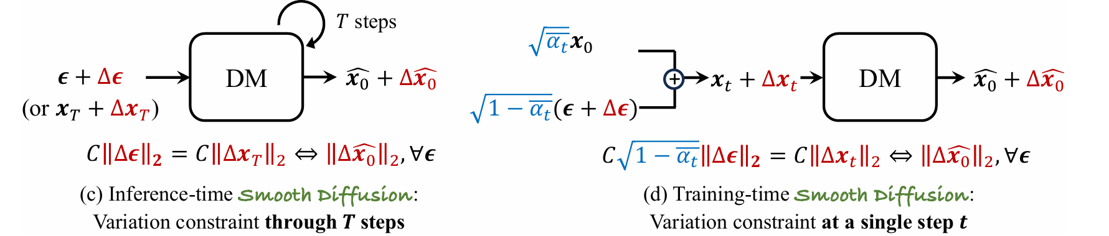

Smooth Diffusion (Guo et. al 2023)
Step-wise Variation Regularization (continued)
Now we are able to comprehend what these graphs mean
Inference time smooth diffusion is the overall objective $∥Δ{\hat{x}}_{0}∥_{2} ⇔ C∥Δx_{T}∥_{2}=C∥Δε∥_{2}, ∀ε$
Training time smooth diffusion is the step-wise variation regularization

Slide 10
Smooth Diffusion (Guo et. al 2023)
Experiment Setup (downstream tasks)
Image interpolation: VAE-space interpolation and ANID
image inversion: integrate Smooth Diffusion and Stable Diffusion with DDIM and Null-text inversion
text-based image editing: SDEdit, Prompt-to-Prompt (P2P) , Plug-and-Play (PnP), Diffusion Disentanglement (Disentangle), Pix2Pix-Zero and Cycle Diffusion

Slide 11
Smooth Diffusion (Guo et. al 2023)
Experiment Setup (implementation)
The smooth diffusion is trained atop pretrained Stable Diffusion V-1.5, using LoRA finetuning technique
The Unet was set as trainable while the parameters for other factors were fixed
4 A100 GPUs three days (trained for 30K iterations with a batch size of 96, 3 samples per GPU)
LAION Aesthetics 6.5+ as the training dataset

Slide 12
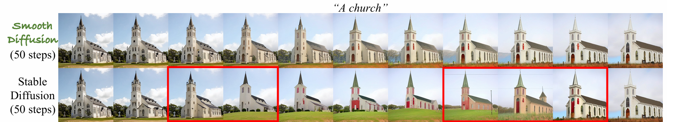
Smooth Diffusion (Guo et. al 2023)
Experiment Setup (evaluation)
The text-to-image generation performance is scored for CLIP and FID
To assess the latent space smoothness, ISTD is used. In fact, the ISTD metric is proposed by this very paper. The metric is evaluated in the following way:
- Sample 500 text prompts from MS-COCO
- For each prompt:
  Sample two Gaussian noise vectors (start/end points)
  Create 9 uniform interpolations between them (0.1 to 0.9 ratios)
  Generate 11 total images (2 endpoints + 9 interpolations)
- Calculate consistency:
  Compute L2 distances between adjacent images in the sequence
  Take standard deviation of these 10 distances
- Final metric: Average the standard deviations across all 500 prompts
image inversion: mean square error, LPIPS, SSIM and PSNR
Perfect smoothness: ISTD = 0
Higher ISTD likely implies visual inconsistency

Slide 13
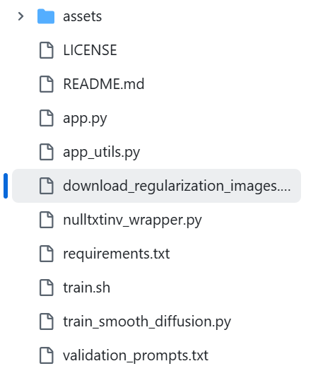
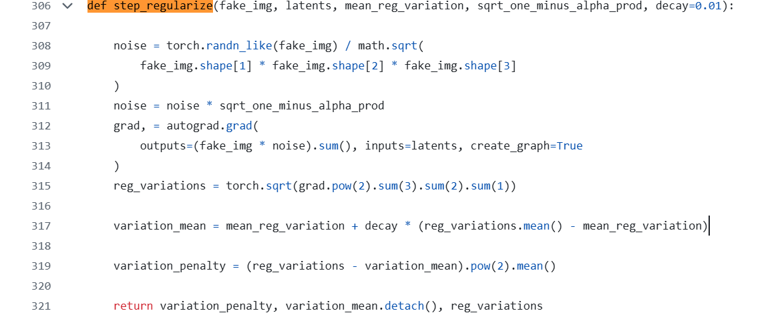
Code
Smooth-Diffusion/train_smooth_diffusion.py at main · SHI-Labs/Smooth-Diffusion · GitHub
Main file – train_smooth_diffusion.py
$$\hat{x_{0}}$$
$$\sqrt{1−\overline{α_{t}}}$$
$$ε$$
a
$$Δ\hat{x_{0}}$$
$$∥Δ\hat{x_{0}}∥_{2}=1$$
$$∇_{ε}\left(\sqrt{1−\overline{α_{t}}}\hat{x_{0}}⋅Δ\hat{x_{0}}\right)$$
new_a = old_a + decay_rate * (new_value - old_a), the decay rate is essentially how much we trust the new value
$$∥∇_{ε}\left(\sqrt{1−\overline{α_{t}}}\hat{x_{0}}⋅Δ\hat{x_{0}}\right)∥_{2}$$
$$𝔼_{Δ\hat{x_{0}},ε}[\sqrt{1−\overline{α_{t}}} ∥J_{ε}^{T}Δ\hat{x_{0}}∥_{2}− a]^{2}$$

Slide 14
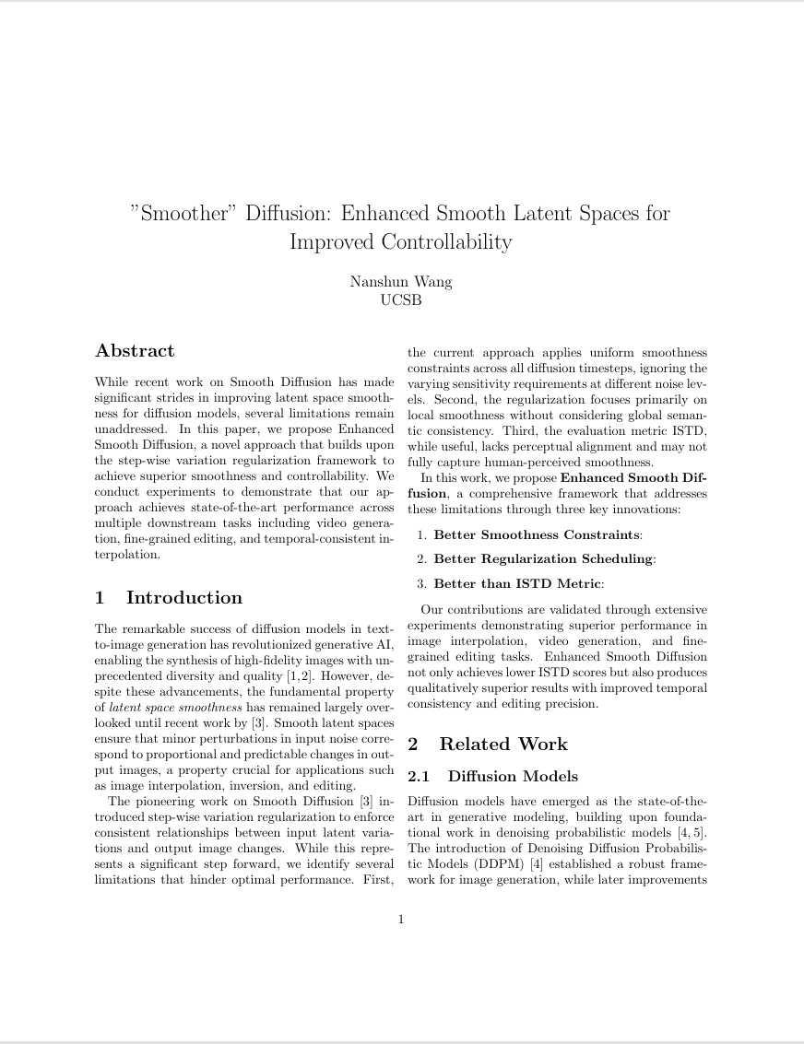
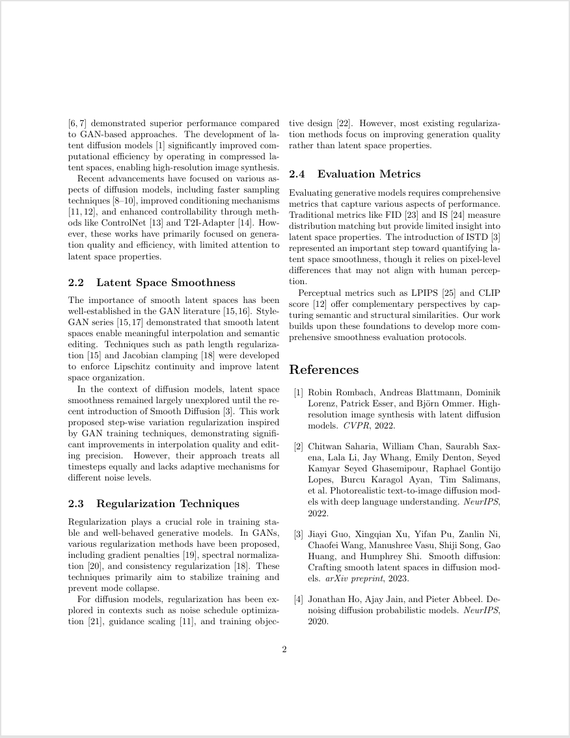
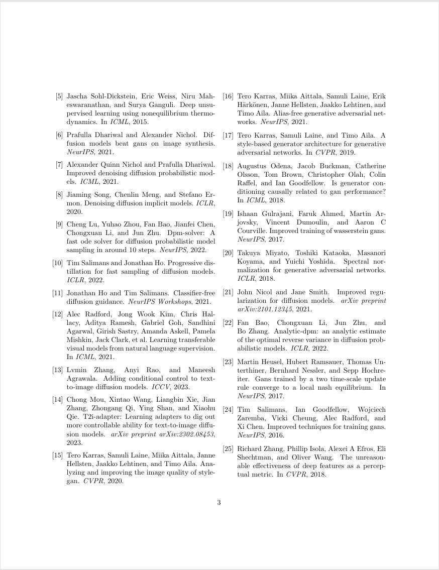
Draft of introduction and related works
Independent Studies paper - Online LaTeX Editor Overleaf

Slide 15
Next Steps
Find new methods for experiment setup/downstream tasks (ex. Image interpolation can have another method apart from VAE-space interpolation and ANID)
Come up with new metric for evaluating smoothness (this paper proposed the ISTD which could be improved in my opinion)
Run code and train original model to validate some examples from the paper
Multimodal work: “One Transformer Fits All Distributions in Multi-Modal Diffusion at Scale”

Slide 16
Thank you for your attention!

